Slide 1
“THEORY OF AUTOMATA”
Total language tree

Slide 2
Summary
Non-Context-Free-languages, Live Production, Dead Production, Theorem, self- embedded nonterminal, Pumping lemma for CFLs, Examples

Slide 3
Non-Context-Free language
There arises a question, whether all languages are CFL? The answer is no.
Languages which are not Context-Free, are called Non-CFL.
To prove the claim that all languages are not Context-Free, the study of machines of word production from the grammar is needed

Slide 4
Live production:
A production of the form nonterminal A string of two nonterminals is called a live production.
A production of the form nonterminal A terminal is called a dead production.
It may be noted that every CFG in CNF has only these types of productions.

Slide 5
Theorem
If a CFG is in CNF and if there is restriction to use the live production at most once each, then only the finite many words can be generated.
It may be noted that every time a live production is applied during the derivation of a word it increases the number of nonterminals by one.
Similarly applying dead production decreases the nonterminals by one. Which shows that to generate a word, one more dead production are applied than the live productions e.g.
S ➔ XY
➔ aY
➔ aa
Here one live and two dead productions are used. In general, if a CFG in CNF has p live and q dead productions then all words generated without repeating any live production have at most (p+1) letters.

Slide 6
Theorem
If a CFG is in CNF with p live and q dead productions and if w is word generated by the CFG, having more than 2^{p} letters then any derivation tree for w has a nonterminal z which is used twice, where the second z is the descended from the first z.
It can be observed from the above theorem that generation tree of word w has more than p rows.

Slide 7
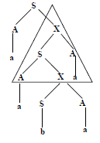
Self-embedded nonterminal
A nonterminal is said to be self-embedded, if in a given derivation of a word, it ever occurs as a tree descendant of itself, as shown in figure aside
Here the nonterminal X is self-embedded.

Slide 8
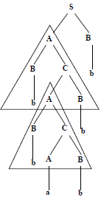
Note
Consider the following CFG in CNF
S → AB
A → BC
C → AB
A → a
B → b
and the derivation tree of the word bbabbb

Slide 9
Note
The part of tree enclosed in upper triangle is identical to that enclosed in lower triangle, there is still another option of replacing A by the same sequence of production shown in lower triangle.
The above fact provides the following pumping lemma for the CFLs.

Slide 10
Pumping lemma for CFLs
Theorem
If G is any CFG in CNF with p live productions, then every word w of length more than 2^{p} can be partitioned into five substrings as w = uvxyz, where x is not null string and v and y are not both null string.
Then all the words of the form uv^{n}xy^{n}z, n = 1,2,3,… can also be generated by G.

Slide 11
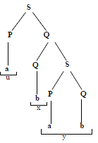
Example
Consider the following CFG which is in CNF
S → PQ
Q → QS|b
P → a
and a word abab generated by
the above CFG with the
following derivation tree

Slide 12
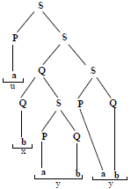
Then w can be broken up as w = uvxyz where u = a, v = Λ, x = b, y = ab, z =Λ
Repeating the triangle from the second Q just as it descends from the first Q, the corresponding tree may be expressed as follows
Which shows that
uvvxyyz=aΛΛbabab Λ=ababab
belongs to the language generated
by the given CFG.
So, it can be generalized that words
of the form uv^{n}xy^{n}z, n=1,2,3,… belong to
the language generated by the given CFG.

Slide 13
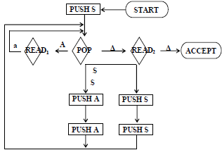
Example
Consider the language EVENA i.e.
EVENA=(aa)^{n} =a2^{n} ={aa, aaaa, aaaaaa, …}
The grammar for this language must be
S → SS|aa and its CNF will be
S → SS|AA, A →a, the PDA for this grammar will be as under

Slide 14
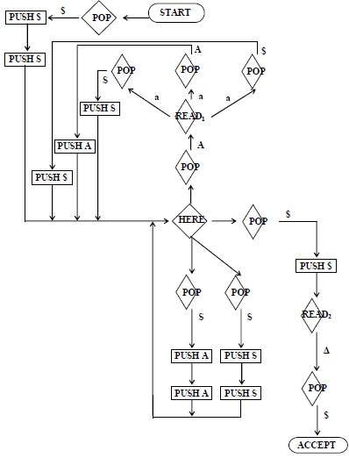
Its corresponding conversion form will be

Slide 15
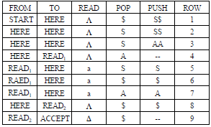
The summary table corresponding to the above PDA in conversion form can be expressed as

Slide 16
Following are the productions defined from the summary table
S → Net(START, ACCEPT, $)
Net(HERE, READ₁, A) → Row4
Net(READ₂, ACCEPT, $) → Row9
Net(START, X, $) → Row₁ Net(HERE, Y, S)Net(Y, X, $)
Net(HERE, X, S) → Row₂ Net(HERE, Y, S)Net(Y, X, S)
Net(START, X, S) → Row₃ Net(HERE, Y, A)Net(Y, X, A)
Net(READ₁, X, S) → Row₅ Net(HERE, X, S) gives four productions
Net(READ₁, X, $) → Row₆ Net(HERE, X, $) gives four productions
Net(READ₁, X, A) → Row₇ Net(HERE, X, A) gives four productions
Net(HERE, ACCEPT, $) → Row₈ Net(READ₂, ACCEPT, $)

Slide 17
Where X and Y are the corresponding joints
In addition to 44 productions following 9 productions complete the required CFG
Row1 → Λ
Row2 → Λ
Row3 → Λ
Row4 → Λ
Row5 → a
Row6 → a
Row7 → a
Row8 → Λ
Row9 → Λ

Slide 18
Summary
Decidability, whether a CFG generates certain string (emptiness), examples, whether a nonterminal is used in the derivation of some word (uselessness), examples, whether a CFL is finite (finiteness), example, whether the given string is generated by the given CFG (membership), example, parsing techniques, top down parsing, example

Slide 19

Decidablity
Following are the decidable problems w.r.t. CFG
Whether or not the given CFG generates any word? Problem of emptiness of CFL.
Whether or not the given CFG generates the finite language? Problem of finiteness.
Whether or not the given string w can be generated by the given CFG? Problem of membership.
Following are algorithms showing that the answers to the above three questions are yes.

Slide 20
Algorithm 1 (Emptiness)
If the given CFG contains a production of the form S Λ, then obviously the corresponding CFL is not empty. If the CFG contains the production of the form S t, where t is a terminal or string of terminal then t is a word of the corresponding CFL and CFL is not empty.
If the CFG contains no such production then For each nonterminal N with N t, pick one production for N (if there are more than one) and replace N by t in the right side of each production wherever it lies. Remove all such productions from the CFG. Doing so the CFG will be changed, it will generate atleast one word of the old CFL.
Repeat the process until either it eliminates S or no new nonterminal is eliminated.
If S has been eliminated then CFG generates some words otherwise not.

Slide 21
Example
S AB, A BSB, B CC
C SS
A a|b
C b|bb
Step (1). Picking A a, C b, it can be written as
S aB
A BSB
A bb
B aaS
B bb
C SS

Slide 22
Step (1). Picking B bb and A bb, it can be written as
S abb
A bbSbb
B aaS
C SS
Since S abb has been obtained so, abb is a word in the corresponding CFL.
To determine whether the nonterminal X is ever used in the derivation of word from the given CFG, following algorithm is used

Slide 23
Algorithm 2 (Uselessness)
Find all unproductive nonterminals (the nonterminal is unproductive if it cannot produce a string of terminals).
Eliminate all productions involving unproductive nonterminals.
Paint all X’s blue.
If any nonterminal is in the left side of the production with any blue nonterminal in the right side, paint that nonterminal blue and paint that nonterminal blue at all occurrences of it throughout the grammar.
Repeat step 4 until no new nonterminal is painted.
If S is blue then X is useful member of CFG, otherwise not.

Slide 24
Example
Consider the following CFG
S Aba | bAZ | b
A Xb | bZa
B bAA
X aZa|aaa
Z ZAbA
Z is unproductive nonterminal, so eliminating the productions involving Z.
S Aba|b
A Xb
B bAA
X aaa

Slide 25
Algorithm 3 (Finiteness)
Determine all useless nonterminals and eliminate all productions involving these nonterminals.
For each of the remaining nonterminals, determine whether they are self-embedded (using the following steps).
Stop if a self-embedded nonterminal is discovered.
To test whether X is self-embedded
Change all X’s on the left side of the productions into a Greek letter Ψ and keep all X’s on the right side as such.
Paint all X’s blue.
If Y is any nonterminal on the left side of the production with X in the right side, then paint Y blue.
Repeat step (c) until no new nonterminal is painted.
If is painted, then the X is self-embedded, otherwise not.
If any nonterminal, left in the grammar, after step 1, is self-embedded then the language generated is infinite, otherwise finite.

Slide 26
Example
Consider the CFG
S ABa|bAZ|b
A Xb|bZa
B bAA
X aZa|bA|aaa
Z ZAbA
Here the nonterminal Z is useless, while all other are used in the derivation of some word. So eliminating the productions involving Z
S ABa|b
A Xb
B bAA
X bA|aaa

Slide 27
Starting with nonterminal X. Replacing X on left side of the production by Ψ
S ABa|b
A Xb
B bAA
A A|aaa
X is blue so A is blue and so is blue. Since A is blue, so B is blue and so S is blue. Since is blue so X is self-embedded and hence the CFG generates the infinite language.

Slide 28
Algorithm 4 (The CYK algorithm)
This algorithm was invented by John Cocke and later was published by Tandao Kasami and Daniel H. Younger.
Convert the given CFG in CNF.
Let the string x under consideration has the form x=x₁x₂x₃…x_{n} here all x is may not be different.
List all the nonterminals in the given CFG, say, S, N₁,N₂, …

Slide 29
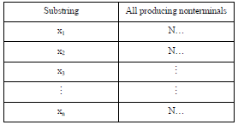
List the nonterminals that generates single letter substrings of x i.e.

Slide 30
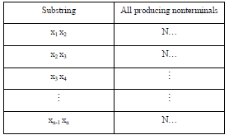
List the nonterminals that generates substrings of length 2 i.e.

Slide 31
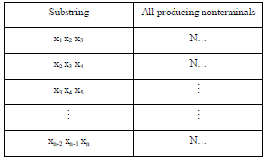
Similarly, list of nonterminals generating substring of x of length 3

Slide 32

Continuing the process, the nonterminals that generate x₁x₂x₃…x_{n} can be determined as

Slide 33
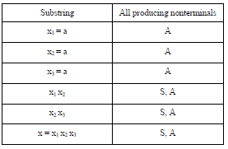
Example
Consider the following CFG in CNF
S AA
A AA
A a
Let x = aaa. To determine whether x can be generated from the given CFG let x = x₁x₂x₃ where x₁ = x₂ = x₃ = a
According to CYK algorithm, the list of nonterminals producing single letter double letter substrings of x and the string x itself, can be determined as follows

Slide 34
Parsing Techniques
Recall the CFG for arithmetic expression
S S+S|S*S|number
It was observed that the word 3+4*5 created ambiguity by considering its value either 23 or 35. To remove this ambiguity, the CFG was modified to
S (S+S)|(S*S)|number
There arises a question that whether a new CFG can be defined without having parentheses with operator hierarchy (i.e. * before +)? The answer is yes. Following is the required PLUS-TIMES grammar
S E, E T+E|T, T F*T|F, F (E)|I

Slide 35

Where i stands for any identifier i.e. number or of storage location name (variable). Following is the derivation of i+i*i

Slide 36
Parsing of word
Definition
The process of finding the derivation of word generated by particular grammar is called parsing.
There are different parsing techniques, containing the following three
Top down parsing.
Bottom up parsing.
Parsing technique for particular grammar of arithmetic expression.

Slide 37
Top down parsing
Example
Consider PLUS-TIMES grammar and a word i+i*i.
As can be observed from the name of top down parsing, the parsing starts from the nonterminal S and the structure similar to that of total language tree is developed. The branches of the tree are extended till the required word is found as a branch.
Some unwanted branches ( the branches that don't lead to the required word) are dropped. For the word i+i*i , the total language tree can be started as

Slide 38
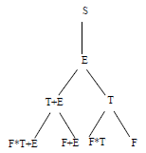
Which can further be extended to

Slide 39
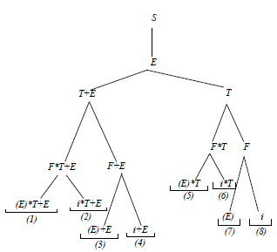

Slide 40
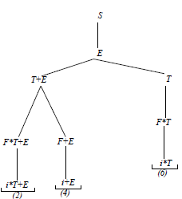
Dropping the unwanted branches 1,3,5,7and 8

Slide 41
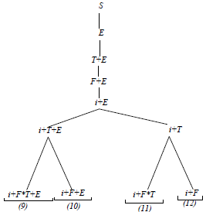
Since first two letters in branches 2 and 6 are not that in i+i*i , so 2 and 6 can be dropped and using left most derivation the nonterminal T is replaced as

Slide 42
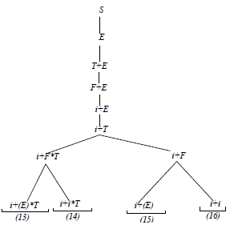
since (9) gives more than five letters and (10) contains two + so (9) and (10) are dropped and left most nonterminal F is replaced as

Slide 43
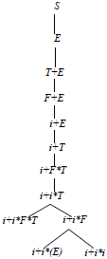
(13), (15) and (16) are again unwanted, so it can be written as

Slide 44

The above tree confirms the required derivation

Slide 45
LINK
www.nature.com/nature/journal/v426/n6965/full/nature02029.html
www.keywordspy.com/overview/domain.aspx?q=language-tree.com

